Slide 1
ASE Project 2
Lamin & Ibrahim 10.12.2024

Slide 2
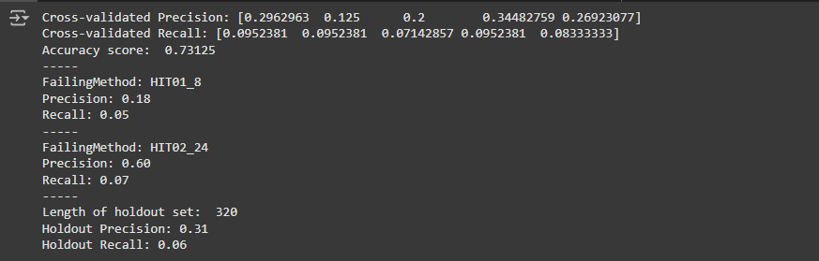
Task 1
Decision Tree Performance.

Slide 3
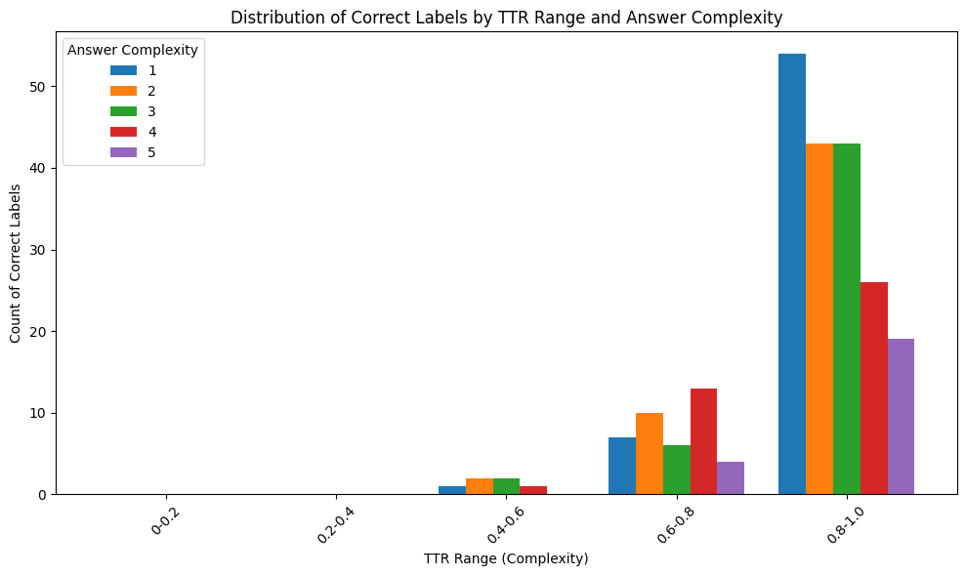

Slide 4
Specification 1
Data Quality
Validation of integrity by checking for outliers and duplicates.
Possible Over-fitting due to data leakage.
Could be improved with multiple column combination
Demographic change adaptation
Static models struggle with evolving user demographics or bug types
Solutions:
Periodically retrain classifiers with updated data.
Utilize active learning to identify and integrate new patterns.
Monitor performance metrics across demographic subgroups.

Slide 5
Specification 2
Explanation Quality Estimate
It is important to measure the clarity, relevance and correctness of the LLM-Generated explanation (consolation content)
Clarity,correctness could be cross checked with:
Human reviews incorporated.
Usage of standard metric evaluation ie. BLUE & ROUGE-L to ensure quality
Collection of feedback for continuous improvement

Slide 6
Prompting
Self-Made Prompt
Basic instructions were provided, as outlined in the project slides.
Additional prompting was required to achieve a result.
LLM-Generated Prompt
Included specific commands to eliminate redundant information.
Required less additional prompting compared to the first approach.
LLM-Generated Prompt w/ Roleplay
The LLM assumed the role of a Software Engineer/Data Scientist working in a company.
The effort required was similar to the second approach.

Slide 7
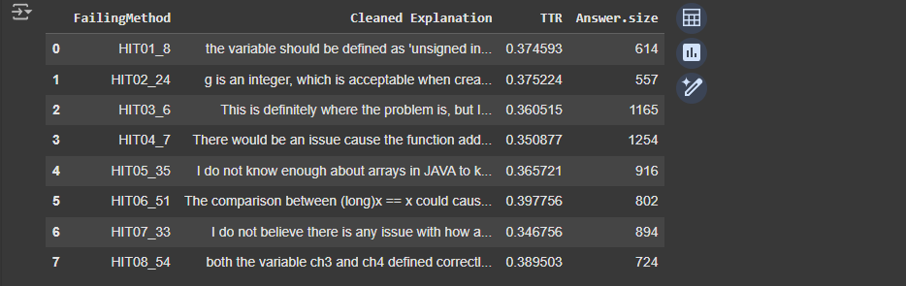
LLM Prompting Approach 1

Slide 8
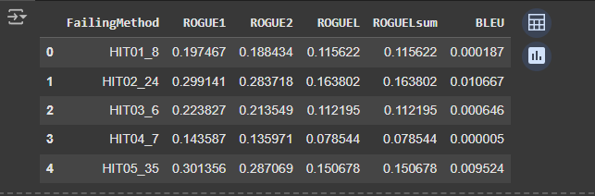
Metrics / Failing Method

